Slide 1
Software Design for Cloud 2
Python Programming
Lecture 5
Lists

Slide 2
List – first Program
An ordered collection of Objects
list1= [1, 2, 3, 4, 5]
list2= [“Mon”, “Tues”, “Wed”, Thur”, “Fri”]
list3= [object1, object2, object3, object3]
N.B. Unlike traditional arrays - Can easily insert/ delete to/from centre of the list

Slide 3
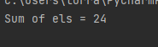
List
def main():
list1= [2, 5, 2, 8, 7]
result = myAdd(list1)
print('Sum of els = {0}'.format( result))
def myAdd(listp):
result = 0
for el in listp:
result = result + el
return result
main()

Slide 4
List (Alternative Implementation)
def main():
list1= [2, 5, 2, 8, 7]
result = myAdd2(list1)
print('Sum of els = {0}'.format( result))
def myAdd2(listp):
result = 0
for index in range(0, len(listp)):
result = result + listp[index]
return result
main()

Slide 5
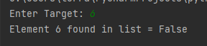
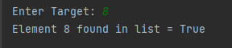
List
def main():
list1= [2, 5, 2, 8, 7]
target = int(input('Enter Target: '))
result = mySearch(list1, target)
print('Element {0} found in list = {1}'.format(target, result))
def mySearch(listp, tar):
result = False
for el in listp:
if (el==tar):
result = True
return result
main()

Slide 6
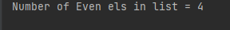
Ex51_ Complete method countEven Ex51_skel.py
def main():
list1 = [2, 5, 2, 8, 7, 3, 2, 5]
result = countEven(list1)
print('Number of Even els in list = {0}'.format(result))
def countEven(listp):
return 0
main()
countEven[2, 5, 2, 8, 7, 3, 2, 5] = 4
If (num%2==0): # to check if a number is Even

Slide 7
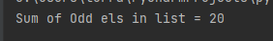
Ex52_ Complete method addOdd Ex52_skel.py
def main():
list1 = [2, 5, 2, 8, 7, 3, 2, 5]
result = addOdd(list1)
print(‘Sum of Odd els in list = {0}'.format(result))
def addOdd(listp):
return 0
main()
addOdd[2, 5, 2, 8, 7, 3, 2, 5] = (5+7+3+5) = 20
If (num%2==1): # to check if a number is Odd

Slide 8

Ex53_ Complete method countTarget Ex53_skel.py
def main():
list1 = [2, 5, 2, 8, 7, 3, 2, 5]
target = int(input('Enter Target: '))
result = countTarget(list1, target)
print('{0} Occurs in List {1} Times'.format(target, result))
def countTarget(listp, tar):
return 0
main()
countTarget([2, 5, 2, 8, 7, 3, 2, 5], 2) = 3

Slide 9
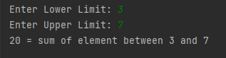
Ex54_ Complete method addInRange Ex54_skel.py
def main():
list1 = [2, 5, 2, 8, 7, 3, 2, 5]
lower = int(input('Enter Lower Limit: '))
upper = int(input('Enter Upper Limit: '))
result = addInRange(list1, lower, upper)
print('{0} = sum of element between {1} and {2}'.format(result, lower, upper))
def addInRange(listp, low, high):
return 0
main()
addInRange([2, 5, 2, 8, 7, 3, 2, 5], 3, 7) = 20 i.e. 5+7+3+5
i.e sum of items in array with a value of between 3 & 7 inclusive
if (cond1 and cond2):

Slide 10
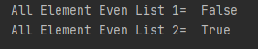
Ex55_ Complete method allEven Ex55_skel.py
def main():
list1 = [2, 6, 2, 7, 8, 4, 2, 6]
result = allEven(list1)
print('All Element Even List 1= {0} '.format(result))
list2 = [2, 6, 2, 8, 8, 4, 2, 6]
result = allEven(list2)
print('All Element Even List 1= {0} '.format(result))
def allEven(listp):
allEven([2, 4,6]) = True
allEven([2, 5,6]) = False
# [2, 6, 2, 7, 8, 4, 2, 6]
# [2, 6, 2, 8, 8, 4, 2, 6]

Slide 11
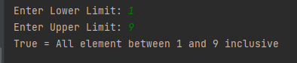
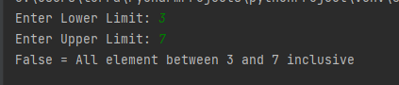
Ex56_ Complete method addInRange Ex56_skel.py
def main():
list1 = [2, 5, 2, 8, 7, 3, 2, 5]
lower = int(input('Enter Lower Limit: '))
upper = int(input('Enter Upper Limit: '))
result = allInRange(list1, lower, upper)
print('{0} = All element between {1} and {2} inclusive'.format(result, lower, upper))
def allInRange(listp, low, high):
return False
main()
allInRange([2, 5, 2, 8, 7, 3, 2, 5], 3, 7) = False (e.g. 2, 8 not in range)
allInRange([2, 5, 2, 8, 7, 3, 2, 5], 2, 8) = True (e.g. 2, 8 not in range)
if (cond1 or cond2):

Slide 12
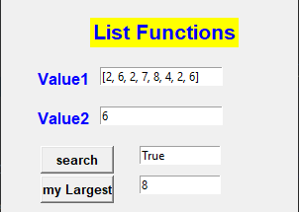
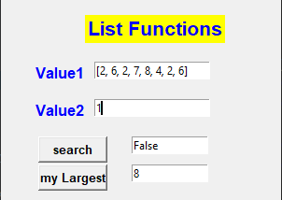
Ex57_ Complete method ‘myLargest’ Ex57_skel.py
def search(list,target):
result = False
for el in list:
if el==target:
result = True
return result
def myLargest(list):
# to be completed
myLargest([2, 5, 2, 8, 7, 3, 2, 5]) = 8
myLargest([ ]) = 0
# assume only positive integers

Slide 13
List Methods:
List.append(x) - add x to end of list
List.count(x) - returns number of times x occurs in the list
list.extend(m) - adds m’s elements to list
list += m - same as above
list.index(x,[s,e]) - returns index of first occurrence of x in range (s,e), or full list if left out
- ValueError exception if not in list
list.insert(i, x) - inserts x at index i
list.pop() - returns and removes rightmost element
list.pop(i) - returns and removes element at position i
list.remove(x) - removes first occurrence of x, otherwise exception
list.reverse() - reverses order of list
list.sort() - sorts elements in ascending order
list.sort([reverse=True]) - descending order
list.sort([key=k]) - key = attribute to use for objects

Slide 14
List of Objects:
We will return to lists to create applications involving:
A Gui
A List of objects

